Slide 1
SAT and ACT Participation Analysis
Joshua Willey

Slide 2
Background
The SAT and ACT are standardized tests taken by high school students that are traditionally used by colleges and universities in their selection of new students.
There has been controversy over whether these tests are fair and accurate predictors of student success, and some universities have recently dropped requirements for applicants to participate in them.
The College Board and ACT, Inc. have been campaigning to maintain their role in the college admissions process.

Slide 3
Problem Statement
As members of a state board of education, we are considering partnership with the College Board or ACT, Inc. in order to increase college-entrance exam participation. The aim of this study is to determine whether or not to mandate a statewide exam, and whether that should be the SAT or ACT.

Slide 4
Reasons for Contract with ACT or SAT
College entrance exams can be used as replacements for in-state assessments.
States are able to negotiate reduced prices per test, and are able to administer them for free to students.
Test becomes more financially accessible to students
More students consider possibility of college
*College Board and ACT, Inc. each currently hold contracts with 20 states provide study materials and administer tests to some or all students for free

Slide 5
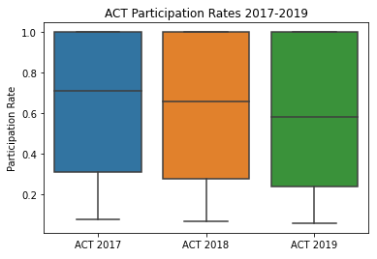
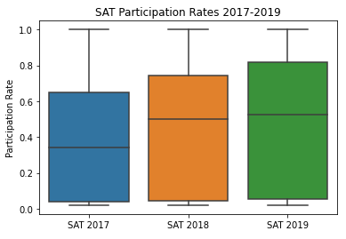
Test Participation 2017-2019
ACT is currently mandated by the highest number of states, but SAT participation has gradually risen since its redesign in 2016.

Slide 6
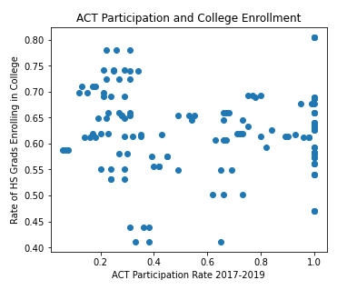
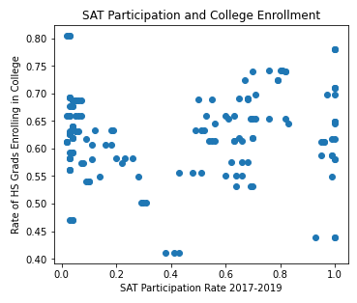
SAT vs. ACT participation as predictors of educational attainment
Rate of High School Grads Enrolling in College (2018)

Slide 7
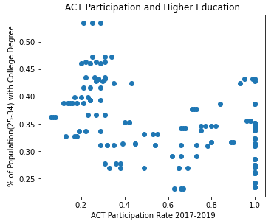
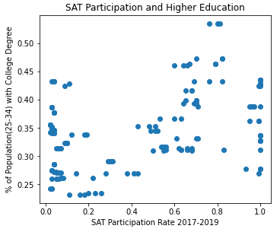
SAT vs. ACT participation as predictors of educational attainment
Percentage of Population with Bachelor’s Degree or Higher (2018)

Slide 8
Colorado and Illinois transitioned to SAT
SAT was redesigned and now aligns with Common Core
Khan Academy provides free SAT prep
College Board offered a better contract than ACT, Inc.
 | ACT |  |  | SAT
 | 2017 | 2018 | 2019 | 2017 | 2018 | 2019
Colorado | 100% | 30% | 20% | 11% | 100% | 100%
Illinois | 93% | 43% | 35% | 9% | 99% | 100%

Slide 9
Recommendations
Partner with the College Board to make SAT testing available and free for all students.
Work with school districts to coordinate free test days and provide study materials.
Continue collecting data regarding relationship between SAT testing and long-term student success.

Slide 10
References
https://blog.prepscholar.com/which-states-require-the-act-full-list-and-advice
https://blog.prepscholar.com/which-states-require-the-sat
https://www.washingtonpost.com/local/education/growing-number-of-states-fund-act-college-admission-testing-for-11th-grade-students/2014/08/19/eb0edcba-27a7-11e4-86ca-6f03cbd15c1a_story.html
https://www.coloradokids.org/wp-content/uploads/2016/01/ACTvsSAT_FINAL.pd
http://www.higheredinfo.org/dbrowser/index.php?submeasure=63&year=2018&level=nation&mode=data&state=
http://www.higheredinfo.org/gyod/

